Slide 1
Urban Analytics at Scale
Bill Howe
Associate Professor, Information School
University of Washington
Director, Cascadia Urban Analytics Cooperative
Notes:
NoSQL has more to do with building scalable web applications than data science and analytics.
However, it’s important to cover the topic, for a few reasons:
1) you will be manipulating data inside of these systems
2) the major systems and terms in this space are influencing people; it’s important to understand the history and trends, so you can make informed technology recommendations when you are asked
3) The same concepts we are discussing come up in this space as well.
4) Data scientists build data products, which may involve the use of these systems.

Slide 2
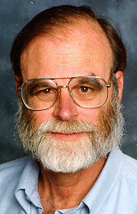


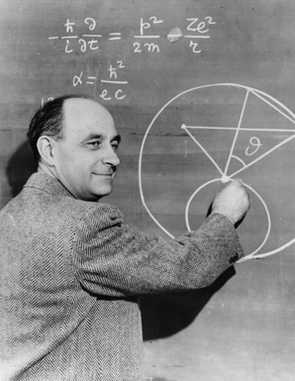



The Fourth Paradigm
Empirical + experimental
Theoretical
Computational
Data-Intensive
Jim Gray
Notes:
2

Slide 3



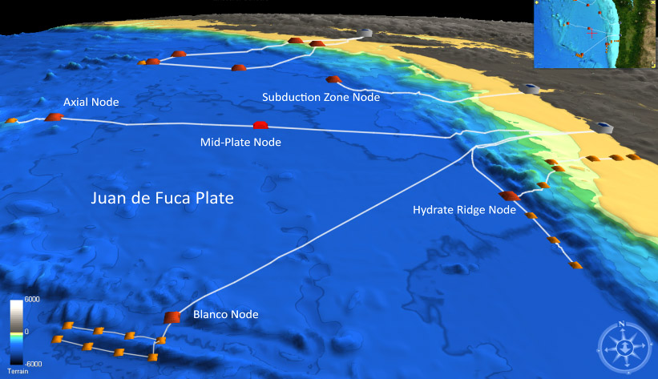

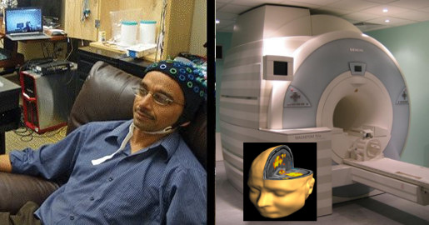

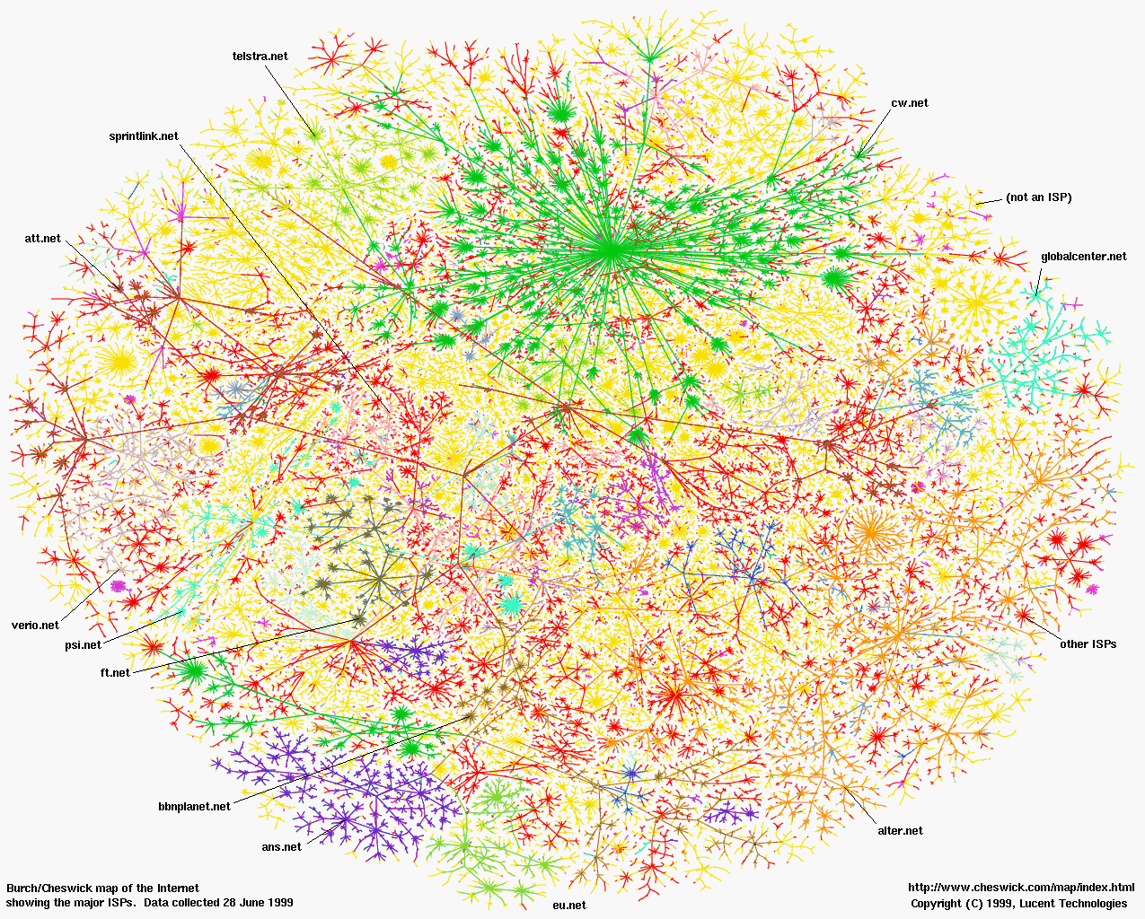
Nearly every field of discovery has been transitioning from “data poor” to “data rich”
Physics: Fermilab, LHC
Astronomy: LSST
Oceanography: OOI
Neuroscience: EEG, fMRI
Biology: Sequencing
Economics
Social Sciences
Notes:
Whether or not you subscribe to the view that this represents a fundamental shift in scientific inquiry or a different name for what had always been going on in science, there was a demonstrable change:
Nearly every field was moving from data poor to data rich, and researchers were using new methods, new tools, and asking new questions

Slide 4
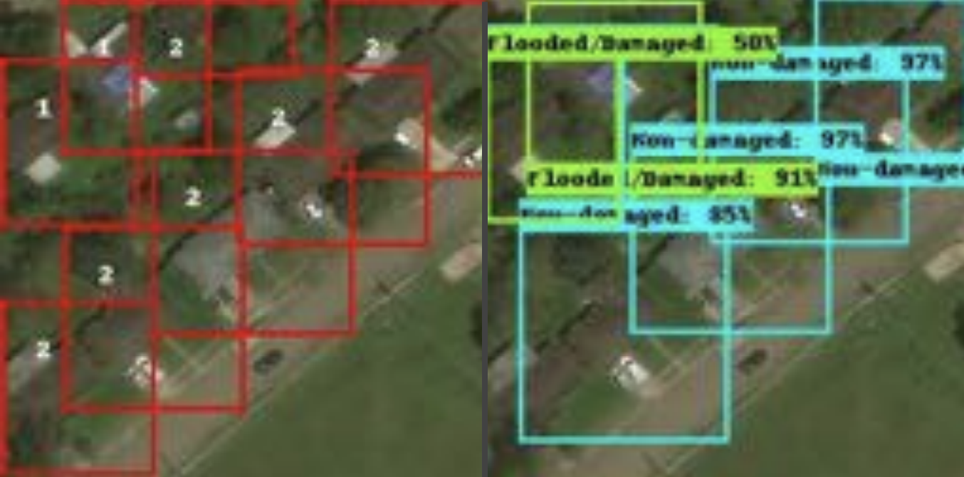
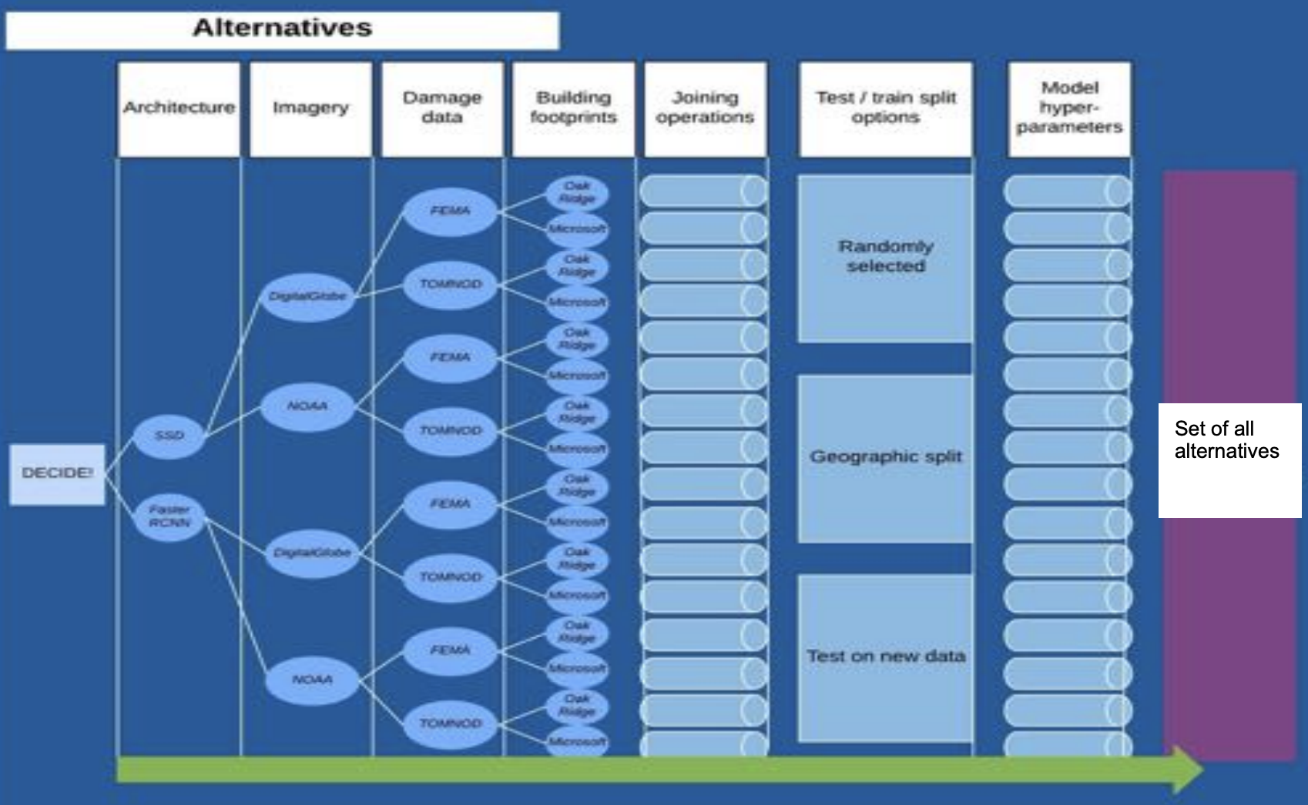
Detecting flood-damaged buildings from satellite imagery using neural networks
Youngjun Choe

Slide 5
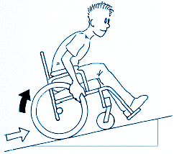


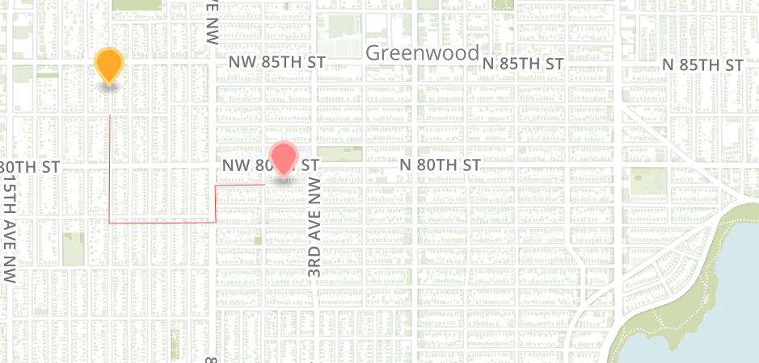
Accessibility, Urban Mobility
powered by data from:
SDOT/Socrata, Google API
Anat Caspi

Slide 6







Housing and homelessness
Transitional housing
Rapid
re-housing
Permanent housing
Emergency shelter
Housing with services
Unsuccessful exit

Slide 7
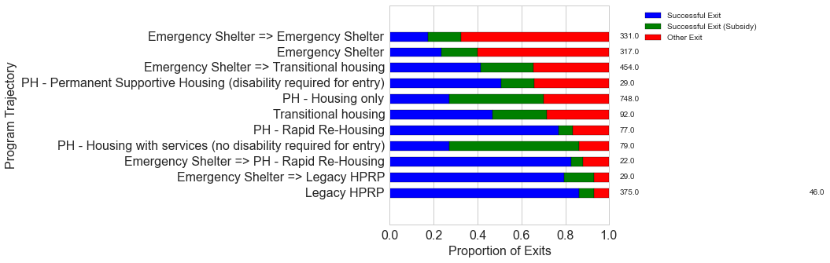
Data: Pierce County
Analyzing Family Trajectories through Programs
Emergency Shelter -> Transitional Housing
Only 40% successful exits
Emergency Shelter -> Rapid Re-housing
80% successful exits
Common trajectories lead to different outcomes:
a successful exit from an episode would mean that the family found a permanent housing solution
a proportion of these still receive government subsidies
other exits are exits back into homelessness, or to other, unknown destinations

Slide 8
City agency
Subject matter experts
Data scientists
Notes:
Subject matter experts and data experts used to be the same people, or at least both worked closely together.

Slide 9
City agency
Subject matter experts
Data scientists
Notes:
But as the methods became more advanced, people became more specialized, and distance between subject matter experts and analysis experts increased

Slide 10
City agency
Subject matter experts
Data scientists
Notes:
And now it’s common for the analysts to have popped out of the organization altogether – vendors, research teams, consultants

Slide 11
City agency
data
context
Notes:
So the subject matter experts need to pass data to the analysts.
Analysts need data to even begin to help.
It’s (technically) easy to hand over data. But wehat is harder to deliver?
Context.
Analyze bus route patterns: We found an anomaly of low ridership over a three-day period. “Ya, it was a snow day”

Slide 12
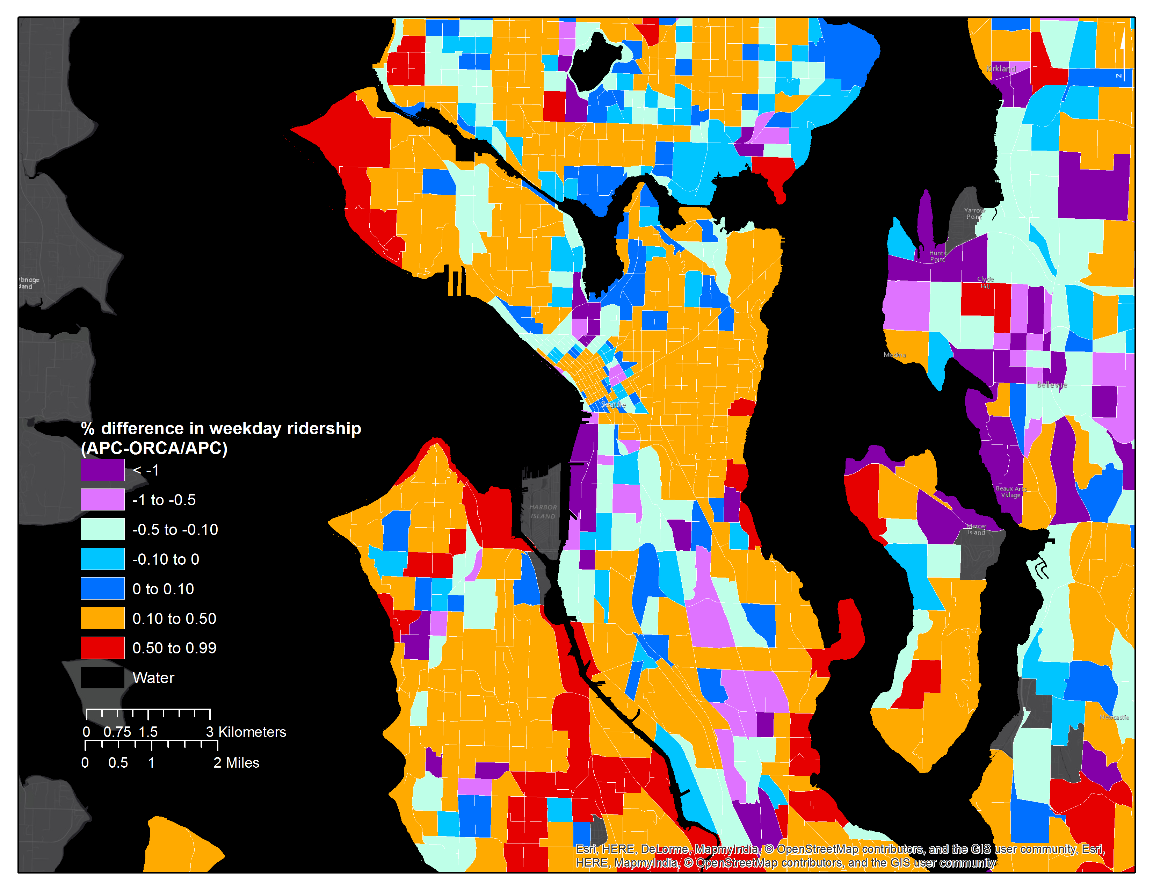

Context is important: ORCA Percentage Difference in Ridership, Seattle
Mark Hallenbeck
TRAC

Slide 13
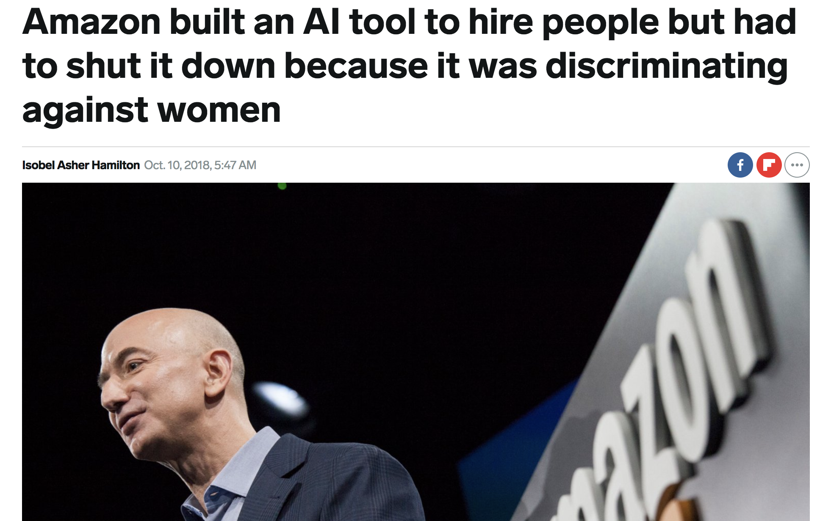
Notes:
And it keeps happening. Amazon trained a model to recognize good resumes. What do you think their training data was? Their own hiring data, which like every other tech firm, doesn’t include enpugh women.

Slide 14
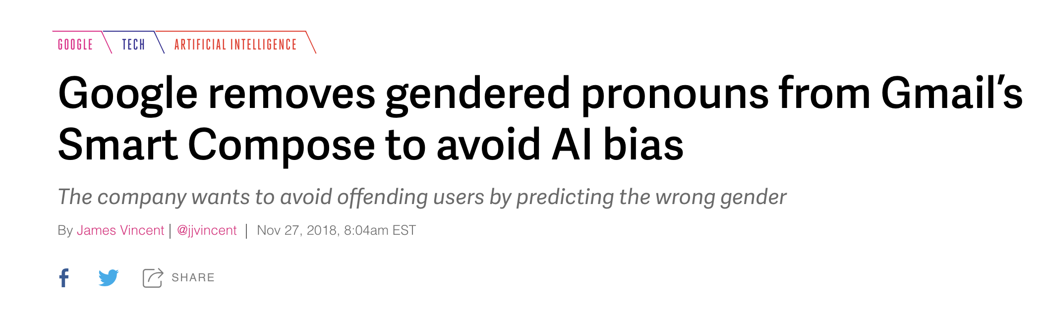
Notes:
Google’s autocomplete email algorithms were assuming that CEOs are all male

Slide 15
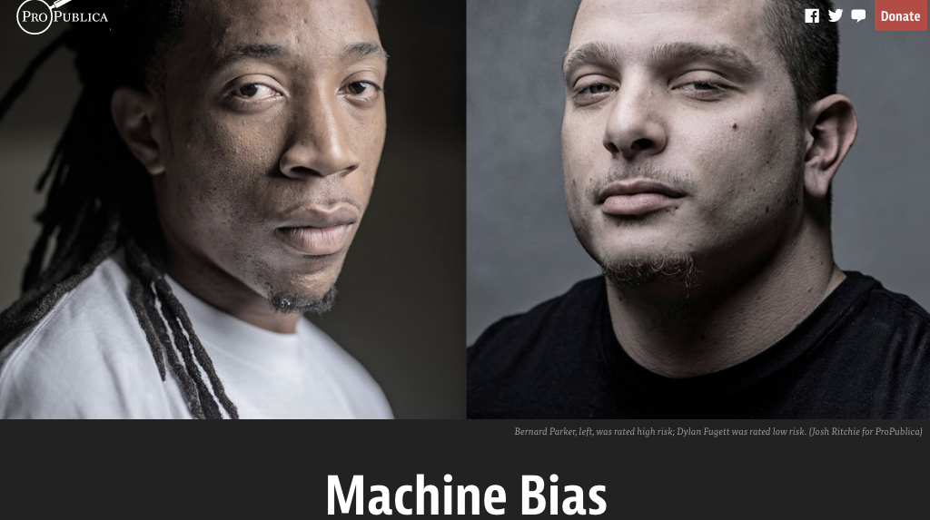
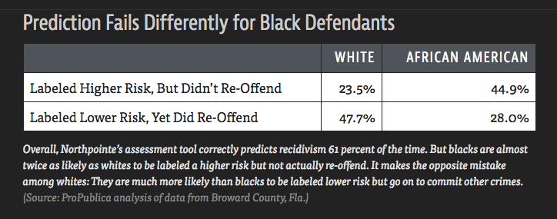
Propublica, May 2016

Slide 16
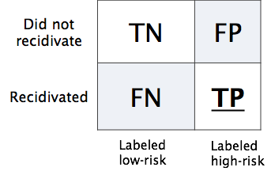
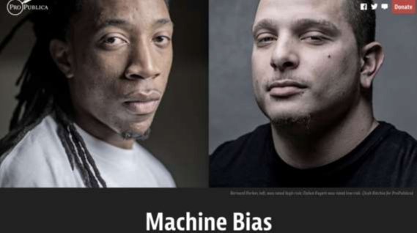
Propublica, May 2016
Predictive Parity: same positive outcome rates across groups, given predictions
Pr(high-risk | black, predicted low-risk) = Pr(high-risk | white, predicted low-risk)
Pr(high-risk | black, predicted high-risk) = Pr(high-risk | white, predicted high-risk)
Equalized Odds: same FP between groups
Pr(predicted high risk | black, low-risk) = Pr(predicted high-risk | white, low-risk)
These are mutually exclusive [Chouldechova 2017]
“21 different fairness metrics, implies hundreds of impossibility theorems”
[Narayanan 2018]
23
Notes:
the Equalized Odds and Predictive Parity are impossible to achieve simultaneously when prevalence of the two populations di ers, meaning Pr(Y = 1|S = 0) Pr(Y = 1|S = 1).

Slide 17
Today
Part 1: Responsible Data Sharing
Privacy
Fairness
Part 2: Neural Methods for Urban Data
ConvLSTM
3DCNNs
First class requirements in the public sector!

